Slide 1
Ingress firewall implementation FreeRTOS
Politecnico di Torino:
Computer Architecture and
Operating Systems course:
2023/2024
Group 5:
Michele Seira, Fardo Giorgio, Luca Ponzo, Gianfranco Trad

Slide 2
Project intent: create a working firewall for FreeRTOS
Requirements :
Function entry points for filtering packets
Handling of rejected packets
Print to stderr
Rule generation
YAML to C struct
Rule storage
Inline C structs in rules.h
(WIP) integration with IDS
Snort

Slide 3
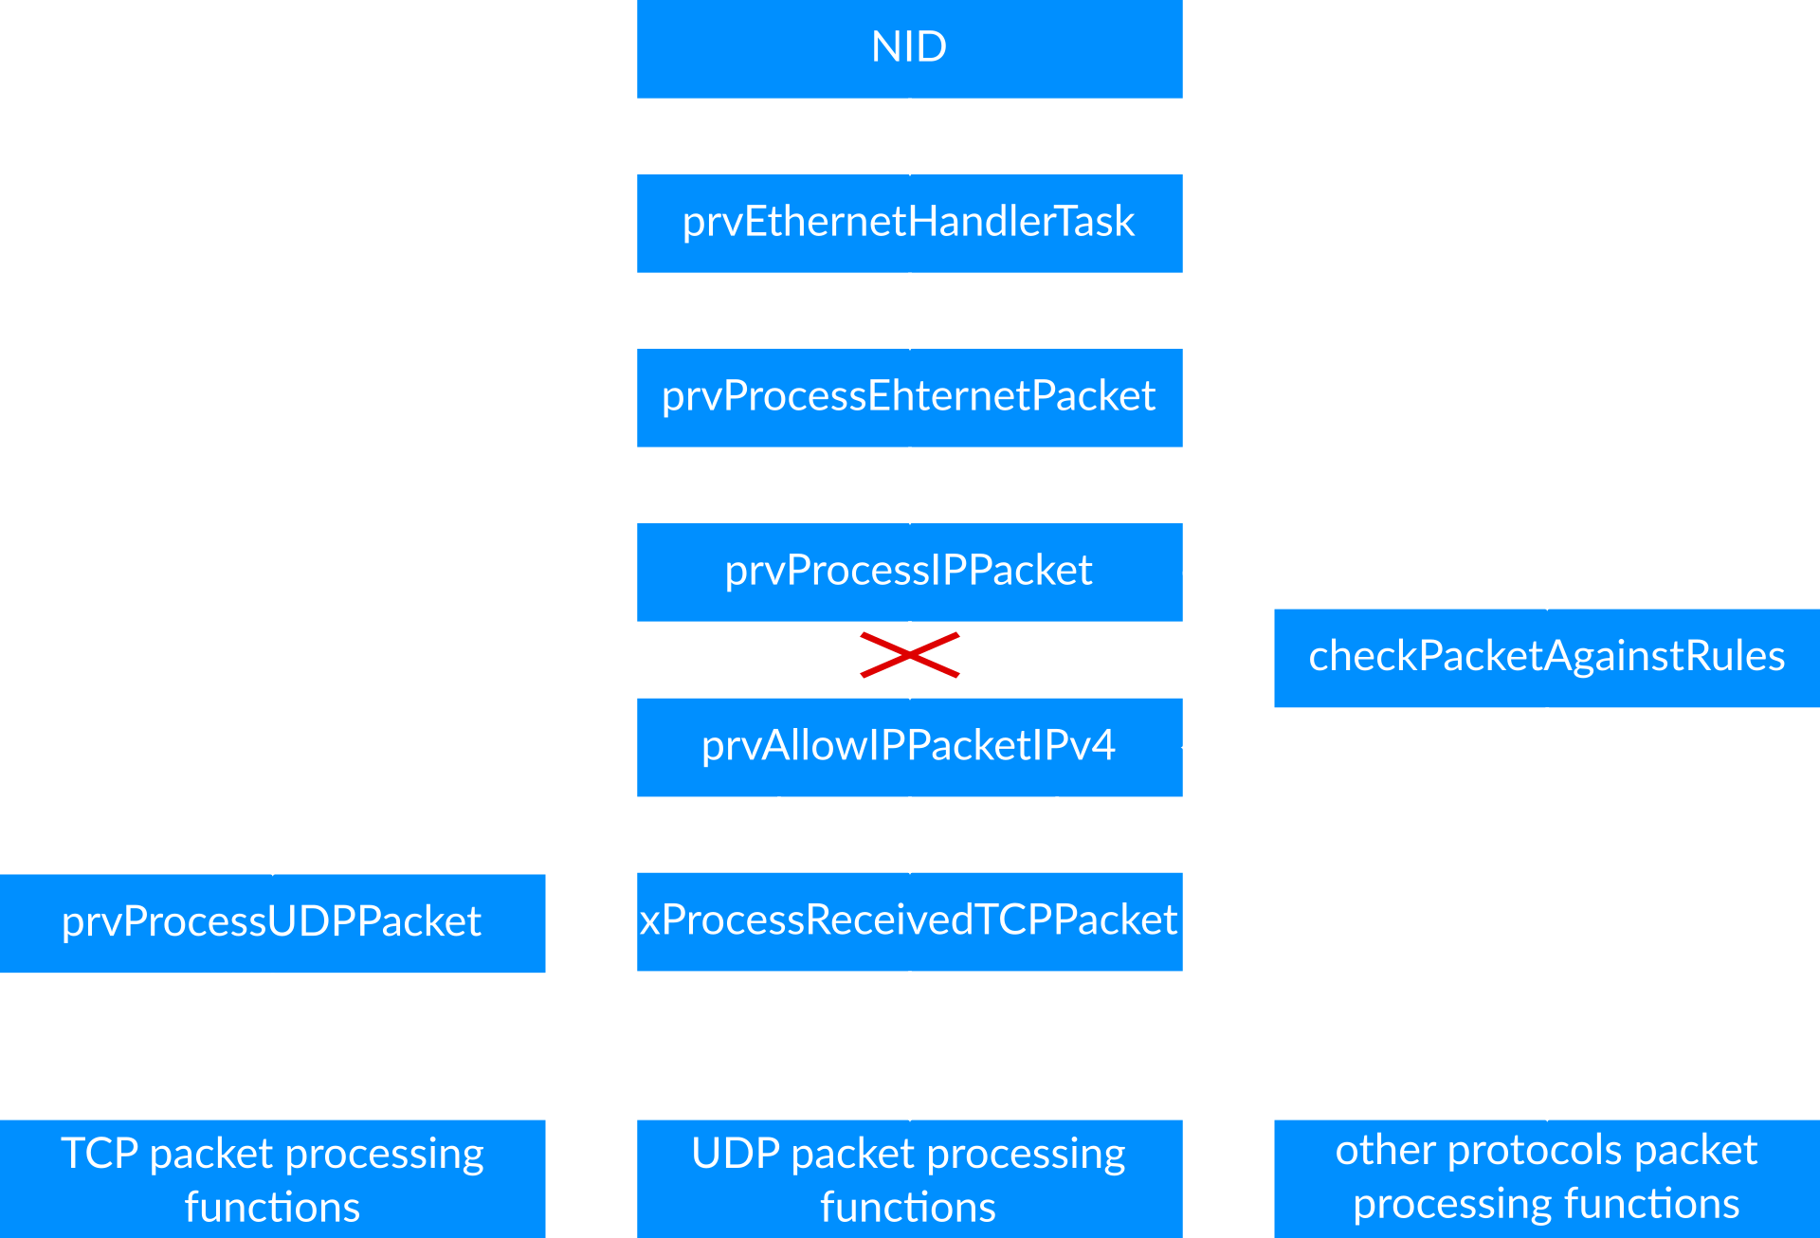
Understanding FreeRTOS IP stack :
Packet processing pipeline

Slide 4
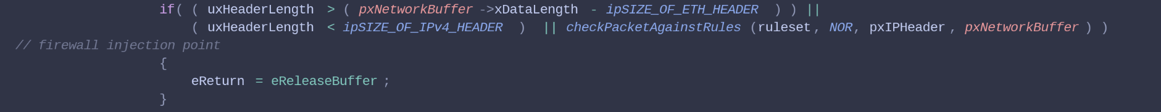
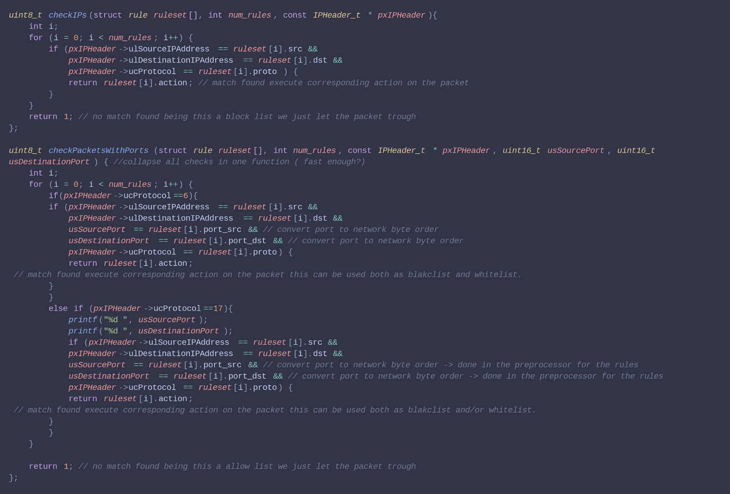
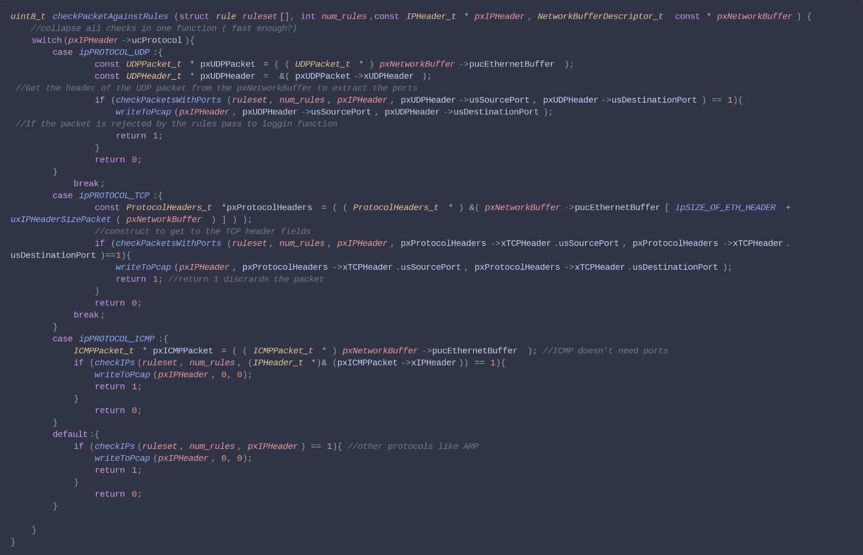
Functions
FreeRTOS_IP.c:prvProcessIPPacket
packet interception point
FreeRTOS_IP.c:checkPacketAgainstRules
FreeRTOS_IP.c:checkIPs & checkPacketsWithPort

Slide 5
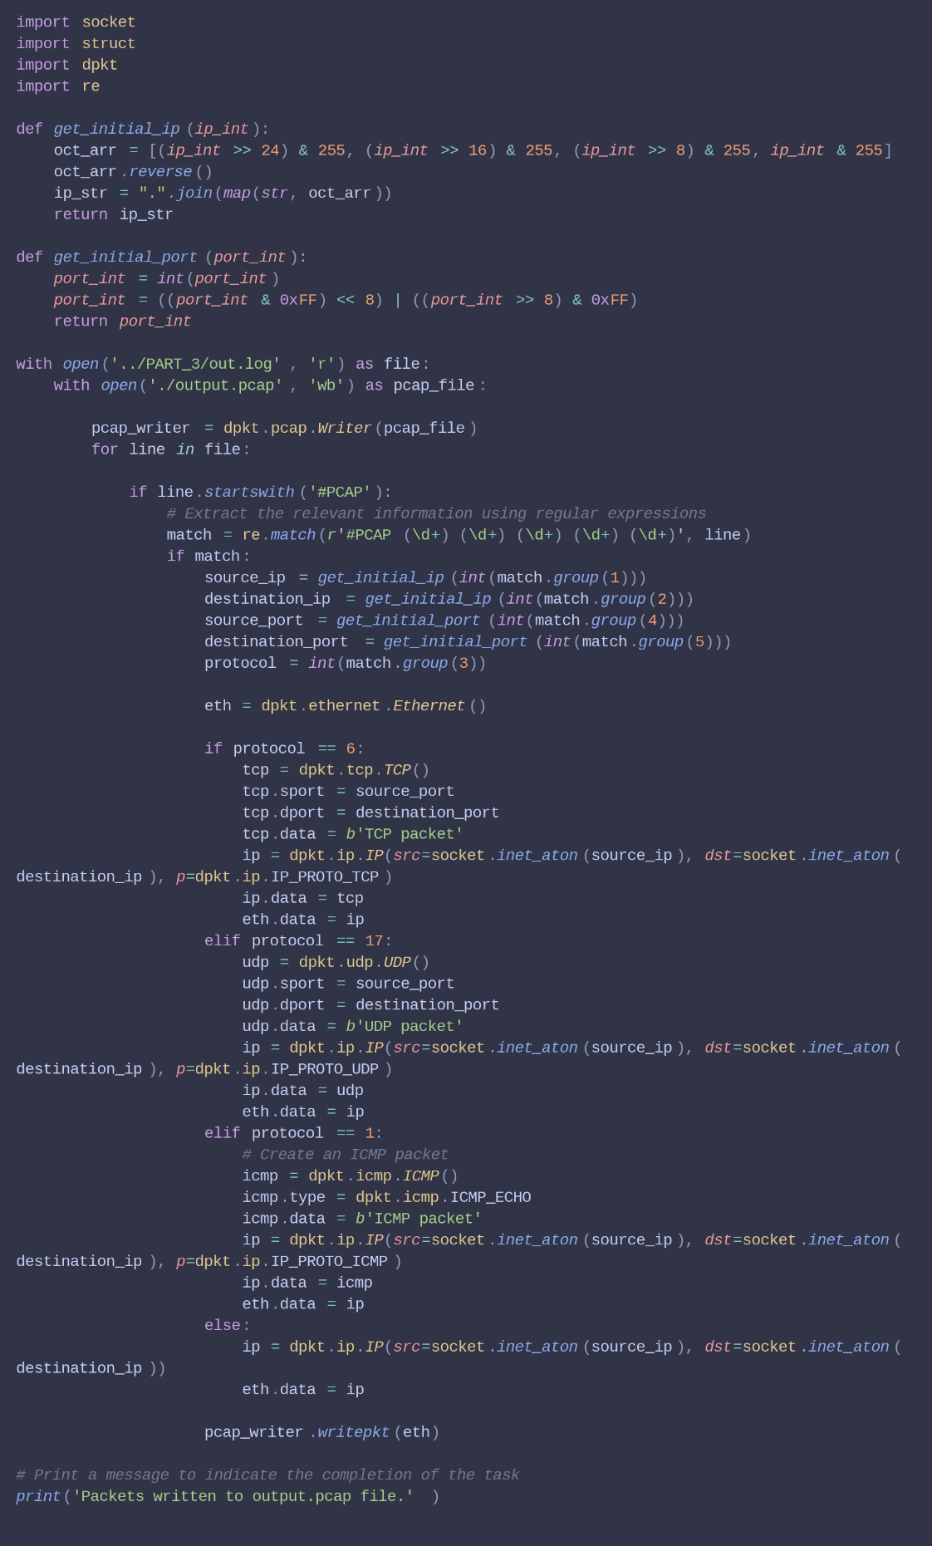
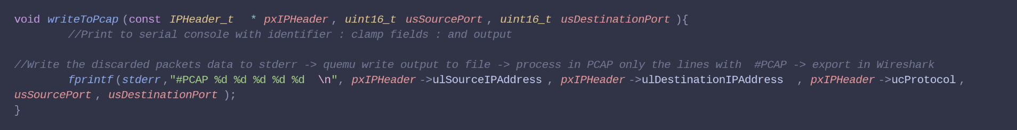
Handling of rejected packets
FreeRTOS_IP.c:writeToPcap
write the data of the rejected packets in stderr
marking every rejected packet with #PCAP
pipe the qemu-system-arm output, that is all directed to stderr, to a file out.log
process the file to compile a pcap
Python .log to PCAP conversion function

Slide 6
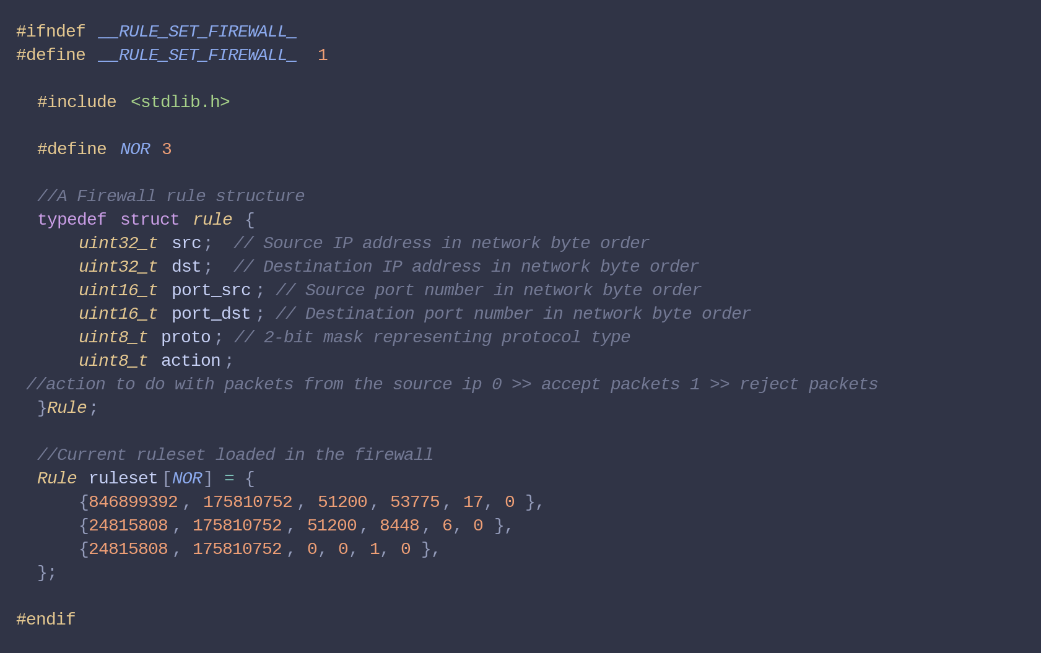
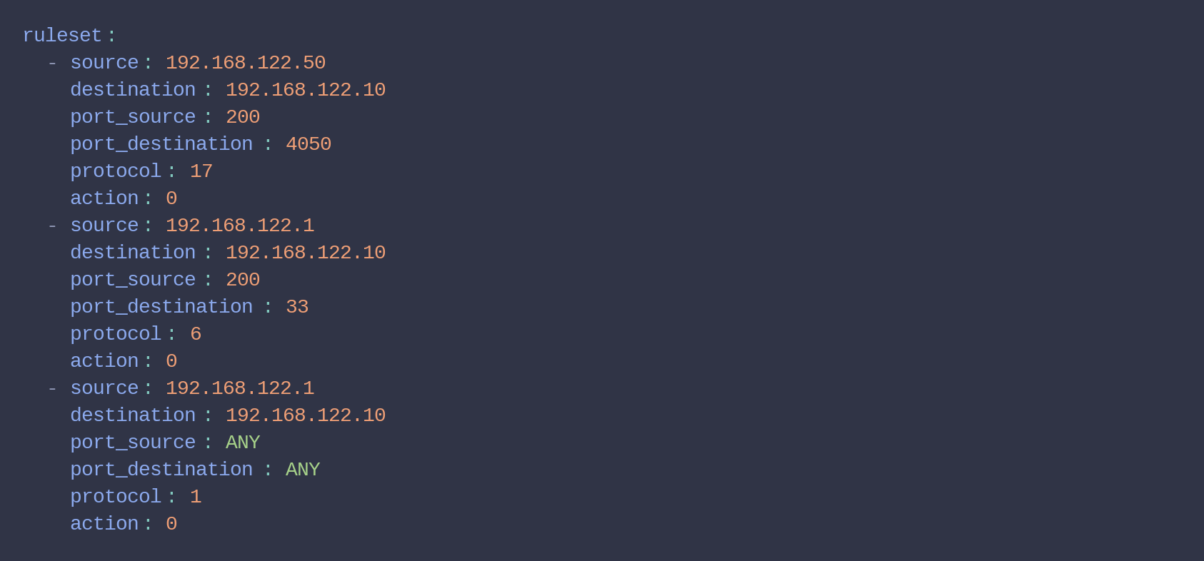
Rules generation
Rules storage
rules.yaml
FreeRTOS-Plus-TCP/rules.h:

Slide 7
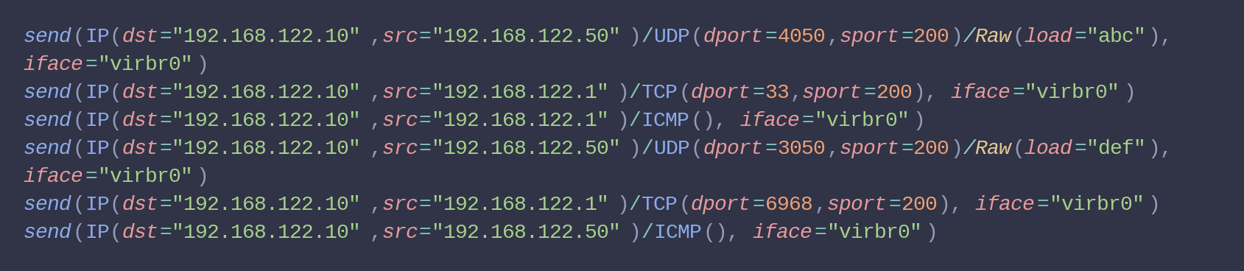
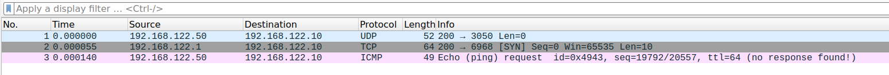
Tests for rules and output PCAP
Packet generation calls that are fed to scapy : 6 packets 3 of which are expected to be rejected by the rules defined earlier
The 3 rejected packets as expected

Slide 8
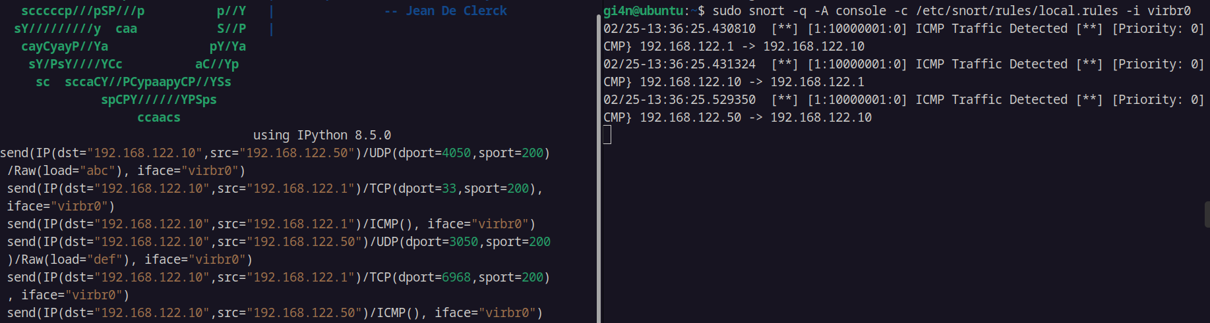
Integration of IDS
preliminary work for POC using SNORT to process rejected packets by the firewall
needs second NIC or SNORT endpoint with TCP retransmission mechanism
Rules defined to monitoring only the ICMP packets through SNORT, only proof of concept needs more work

Slide 9
Thanks !
And now time for the live demo 🙅

